Slide 1
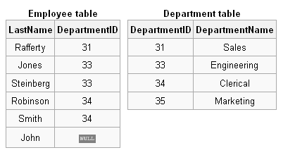
Why we need joins?
Write a query to display the employee names along with their department names.
Output should be like:
Department name Employee name

Slide 2
SQL Join Algorithms
Part 1

Slide 3
In SQL joins are used to get data from two or more tables based on relationship between some of the columns in tables.
Several different types of JOINs can be performed in SQL. The key ones are as follows:
Cross join
Inner join(composite, equi, non equi)
Outer join(left, right, full)

Slide 4
Join Syntax
Select
From
Join
On
Where

Slide 5
Cross Join
A cross join (also called a Cartesian join) is a join of tables without specifying the join condition.
In this scenario, the query would return all possible combination of the tables in the SQL query.
CROSS JOIN returns the Cartesian product of rows from tables in the join.
In other words, it will produce rows which combine each row from the first table with each row from the second table.

Slide 6
Cartesian product
In mathematics, a Cartesian product (or product set) is the direct product of two sets.
Specifically, the Cartesian product of two sets X (for example the points on an x-axis) and Y (for example the points on a y-axis),
denoted X × Y, is the set of all possible ordered pairs whose first component is a member of X and whose second component is a member of Y (e.g., the whole of the x–y plane):

Slide 7
Example
A = {1,2}; B = {3,4}
A × B = {1,2} × {3,4} = {(1,3), (1,4), (2,3), (2,4)}

Slide 8
Example query of cross join

Slide 9
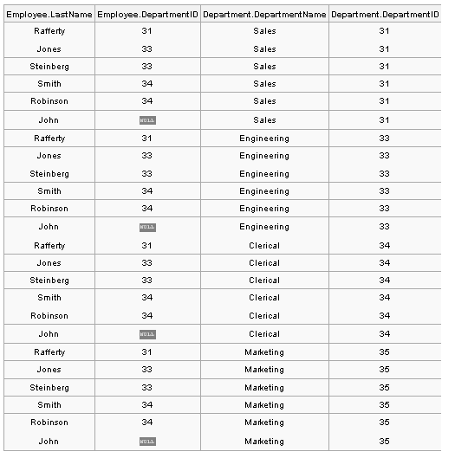
SELECT *
FROM employee
CROSS JOIN department;

Slide 10
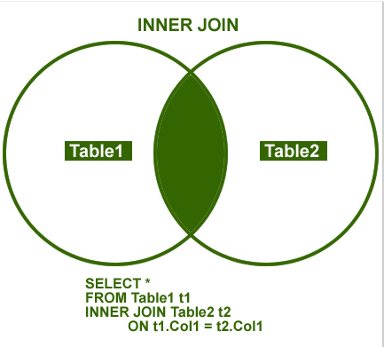
Inner join
Inner join creates a new result table by taking
Cartesian product
filter (join predicate)
An inner join in SQL returns rows where there is at least one match on both tables.

Slide 11
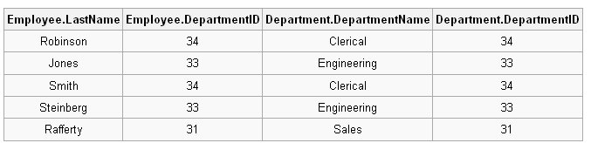
Example query of inner join
SELECT *
FROM employee
INNER JOIN department
ON employee.DepartmentID = department.DepartmentID;

Slide 12
Some more types of join

Slide 13
Composite join
Has more than one condition on single ON clause.
Example:
Select *
FROM Table1 AS T1
INNER JOIN Table2 AS T2
ON T1.col1 = T2.col1 AND T1.col2 = T2.col2

Slide 14
Equijoin
Has an only equality comparison on join predicate.
Example:
Select *
FROM Table1 AS T1
INNER JOIN Table2 AS T2
ON T1.col1 = T2.col1

Slide 15
Non-equijoin
Has other operator than equality on join predicate.
Select *
FROM Table1 AS T1
INNER JOIN Table2 AS T2
ON T1.col1 != T2.col1

Slide 16
Multitable join
Use to join more than two tables. Processing starts from left to right.
Select *
FROM Table1 AS T1
INNER JOIN Table2 AS T2
ON T1.col1 = T2.col1
INNER JOIN Table3 AS T3
ON T2.col1 = T3.col1

Slide 17
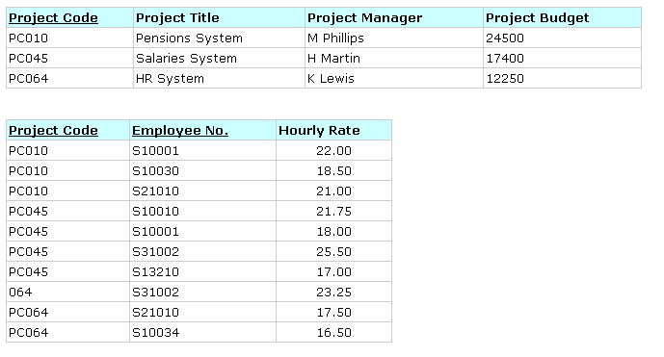
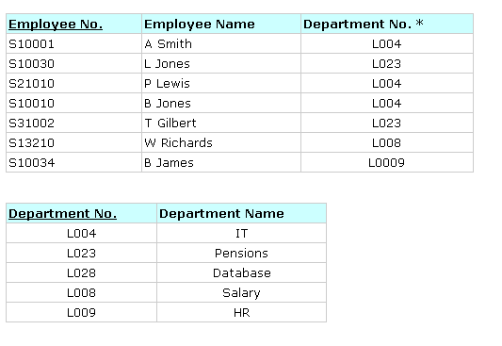
3NF Tables: Non-Key Dependencies Removed
Write a query to display the employee names along with the project title on which they are working.

Slide 18
Select e.EmployeeName, p.projectTitle
From Employee As e
Inner join projectEmployee As pe
On e.EmployeeNo = pe.EmployeeNo
Inner join project as p
On pe.ProjectCode = P.ProjectCode

Slide 19
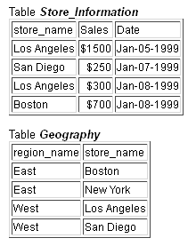

Class Activity
Write a query to find out sales by region.
Output should like:

Slide 20


